Slide 1
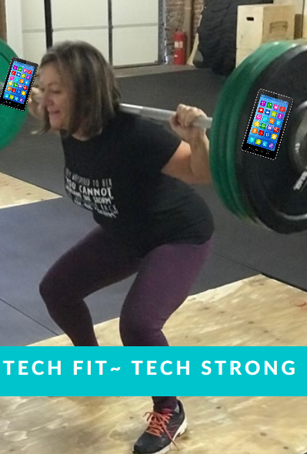
Tech Fit Strategies for 21st Century
Presented by Katherine Carol

Slide 3
Preparing for the world as it is…not as it was.

Slide 4
/
Resource Mapping.

Slide 5
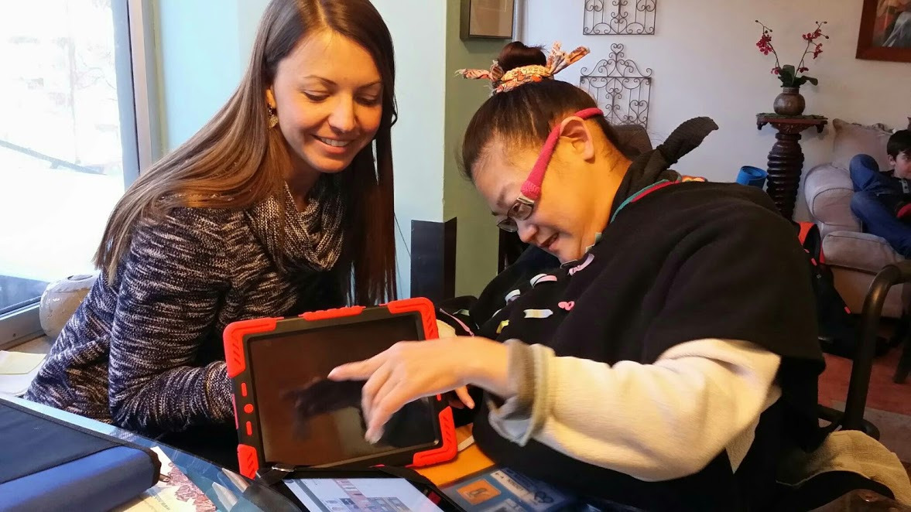
Mikelle uses her technology to:
Run her business.
Set her schedule.
Interview and hire her staff.
Train her staff.
Text her friends and families using Siri and Talk Chat

Slide 6
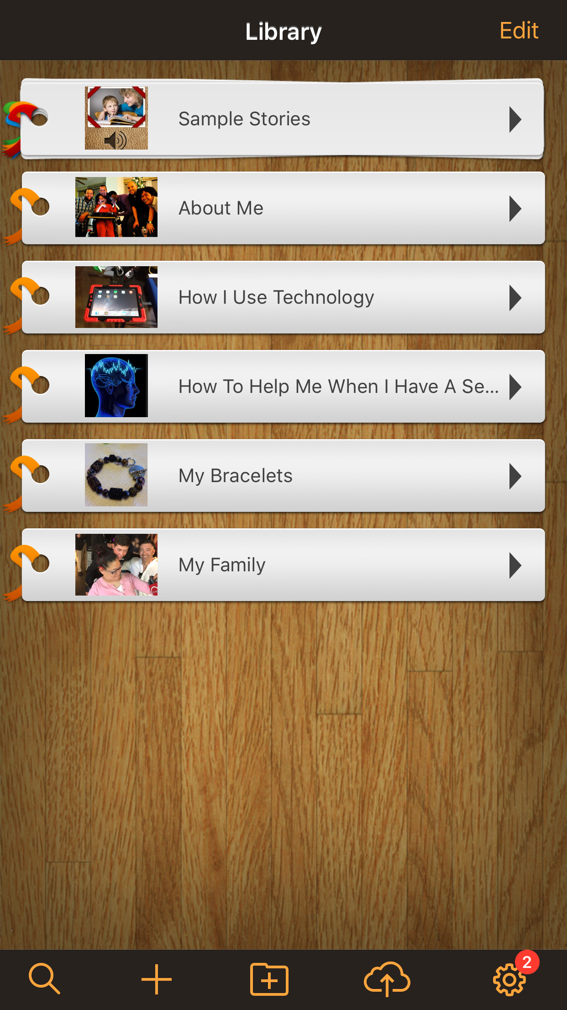
Pictello App

Slide 7
Apps and Application

