Slide 1
Apps and Application

Slide 2
Siri

Slide 3
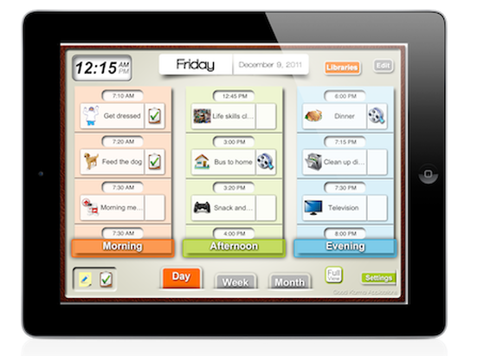
Visual Scheduler

