Slide 1
Building Provider Capacity to Support Individuals with Complex Needs via Technical Assistance Partnerships
Brandi Kelly, PhD; Amy Greer, PhD; & Angela Shockley, RN
Partnership of the Louisiana Department of Health and Hospitals/Office for Citizens with Developmental Disabilities & The Louisiana DD Council

Slide 2
Objectives
1. Attendees will be able to identify core training components to enhance provider capacity to support individuals with complex needs
2. Attendees will be able to identify at least 2 key tools/strategies providers may implement to enhance outcomes for individuals with complex needs
3. Attendees will be able to identify at least 2 key considerations in using data to determine outcomes and initiate improvements

Slide 3
When Complex Needs are Present: Why Can’t We See the Person’s Vision?
Medical Issues
Behavioral Health Issues
Number and complexity of medical needs
Risks associated with medical issues & fear of liability
Assumptions about individual’s ability (or lack thereof) to understand and make decision
All or nothing thinking
The power of the “MD”
Belief that the person has to “be good” before he/she can “have fun”
All or nothing thinking about choices
Rights/responsibility challenges
Risks associated with some behavioral issues and fear of liability
Challenges in accessing needed professional supports
Notes:
Provide examples
Allude to the challenges and balancing that needs to be considered – to be discussed later

Slide 4
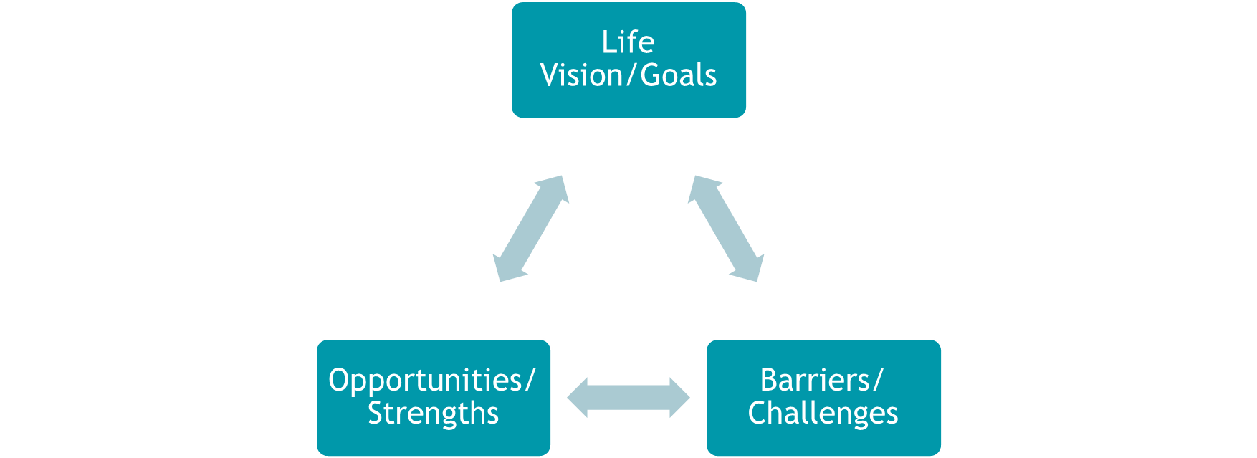
So What Does All this Complicated Stuff Mean Anyway? Putting Medical and Behavioral Information in Context
Notes:
Health & Behavioral Health changes must matter to person for change to occur
Start = Tie to how these things get in the way of the life the person wants
Bring in Important daily, social, community aspects of life
Routines & non-negotiables
Preferences
Community connections & relationships
Meaningful work/fun
Choice & Control
Rights & Responsibilities

Slide 5
How Does This Shape the Process?
Person Centered Discovery (Getting to Know the Person)
What
When/How much
With whom
Non-negotiables
Assessment Information
Day to day needs (functional skills)
Medical needs & risks
Behavioral needs & risks
Plan of Support
Vision→Goals
->Independence
->Typical Support
->Needed Support
->Med/Beh Treatment

Slide 6
Emotional Wellness & Positive Behavior Supports

Slide 7
Wellness and BH Tools
Emotional Wellness Guide
Life Skills Checklist
Professional Consultation Guidelines for Emotional/Behavioral Episodes
Crisis Prevention Plan

Slide 8
Health Supports

Slide 9
Health Related Tools
Nursing documentation
  RN Delegation Sample Form
  Guidelines for Didactic Training & Establishment of Competency
  Sample RN Responsibilities Guide
Nursing Physical Assessment/Reassessment formats
Modified DSP Daily Progress Note for Medical Complexities
Medication Administration Documentation Forms
  MAR/MOR
Medical Consultation/Physician Communication Form

Slide 10
Questions

