Slide 1
Notes:
So, what is the LDH Business Plan?
An expansive, agency-wide strategy tightly focused on LDH’s core goal of improving health outcomes through a series of major commitments, initiatives and goals
Business plans do not encompass all of what we’re doing, because the breadth of LDH is enormous. Our programs and services directly or indirectly impact every Louisiana resident.

Slide 2
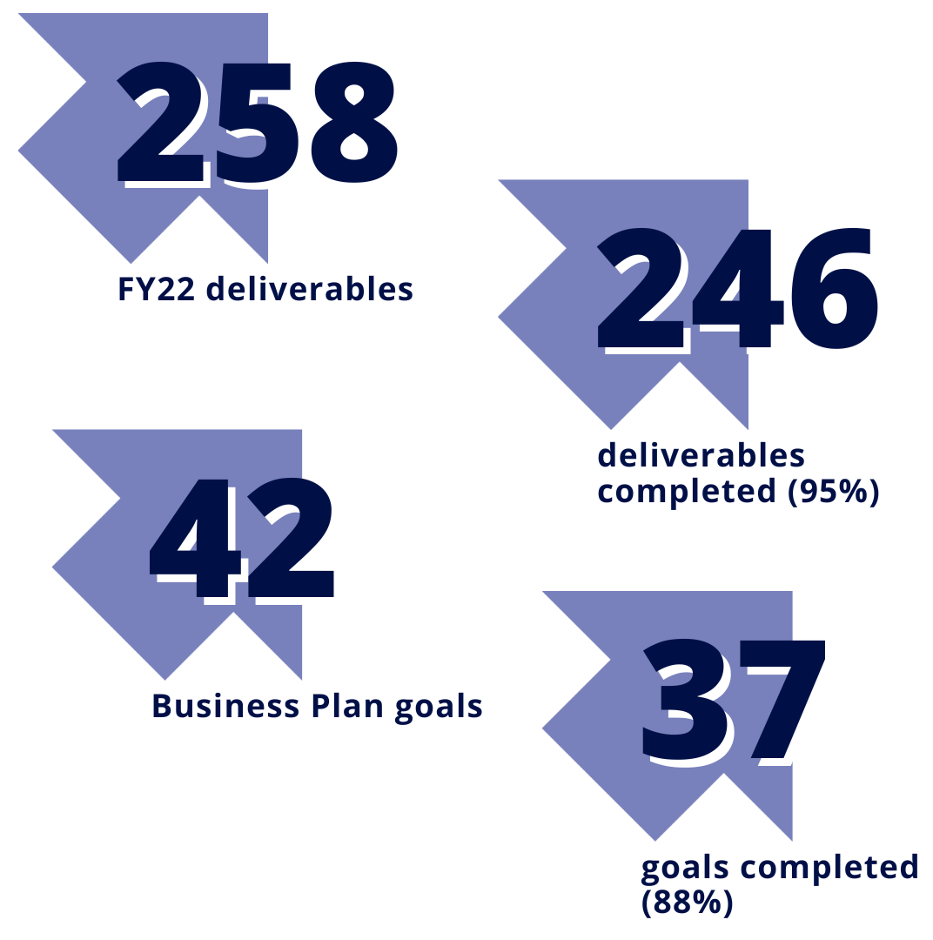
OUR COMMITMENTS:
FY 2022 LDH Business Plan | Together: Building a Stronger LDH and a Healthier Louisiana
Improve the Health and Well-Being of Louisianans with an Emphasis on Prevention
Reshape #TeamLDH Culture
Enhance Customer Service, Partnerships, and Community Relationships
Promote Transparency, Accountability, and Compliance
OUR OUTCOMES:
Through strong partnerships, purposeful work, and innovative strategies, LDH completed 95% of our 258 deliverables* and 88% of our 42 goals.
Notes:
Together: Building a Stronger LDH and a Healthier Louisiana defined how LDH measurably improved its programs, services, and outcomes for Fiscal Year 2022 (July 1, 2021-June 30, 2022).
This work has led to purposeful improvements in key areas, like behavioral and maternal health, chronic disease prevention and detection, and public water systems, among others.
In the spirit of our fourth commitment, we have prepared an outcomes report to the public on our progress in meeting these 42 goals and accomplishing these 258 deliverables.
*Deliverables adjusted since original print of Business Plan:
Initiative 1 — One deliverable was moved from Goal 1 to Goal 2.
Initiative 6, Goal 2 — One new deliverable replaced two deliverables that were printed in the original plan.
Initiative 16, Goal 3 — One deliverable was N/A as it relates to the ending of the COVID-19 Public Health Emergency.

Slide 3
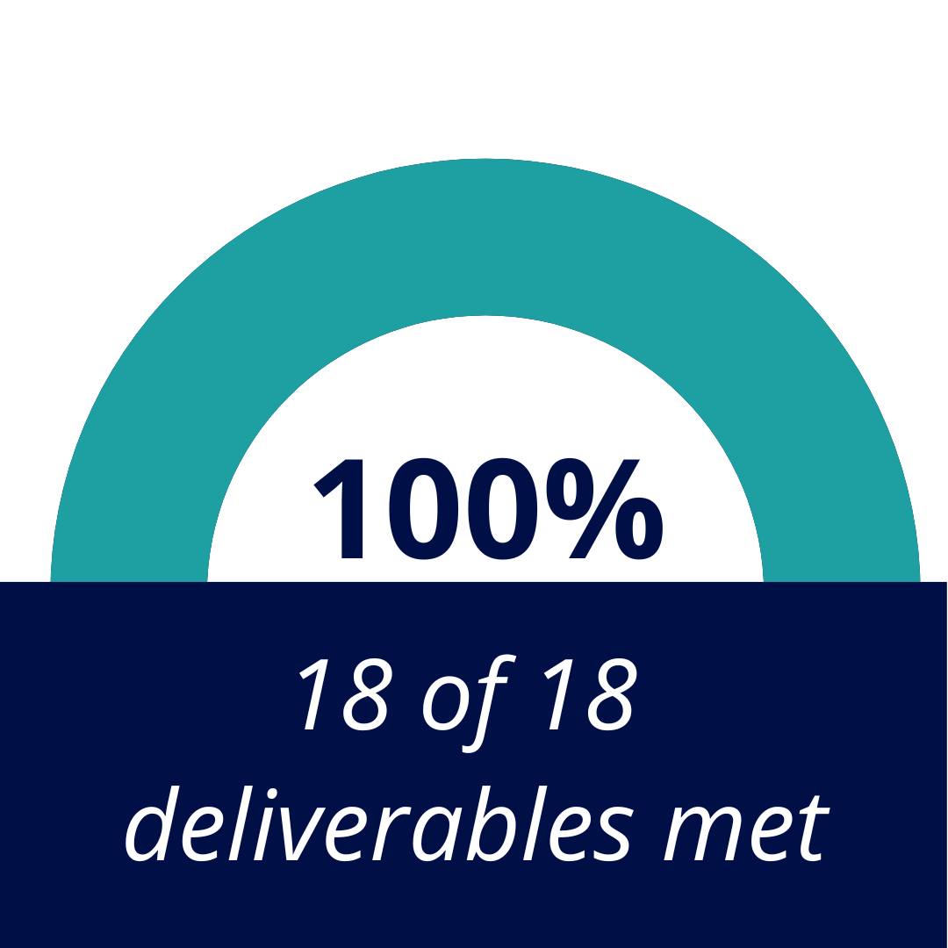
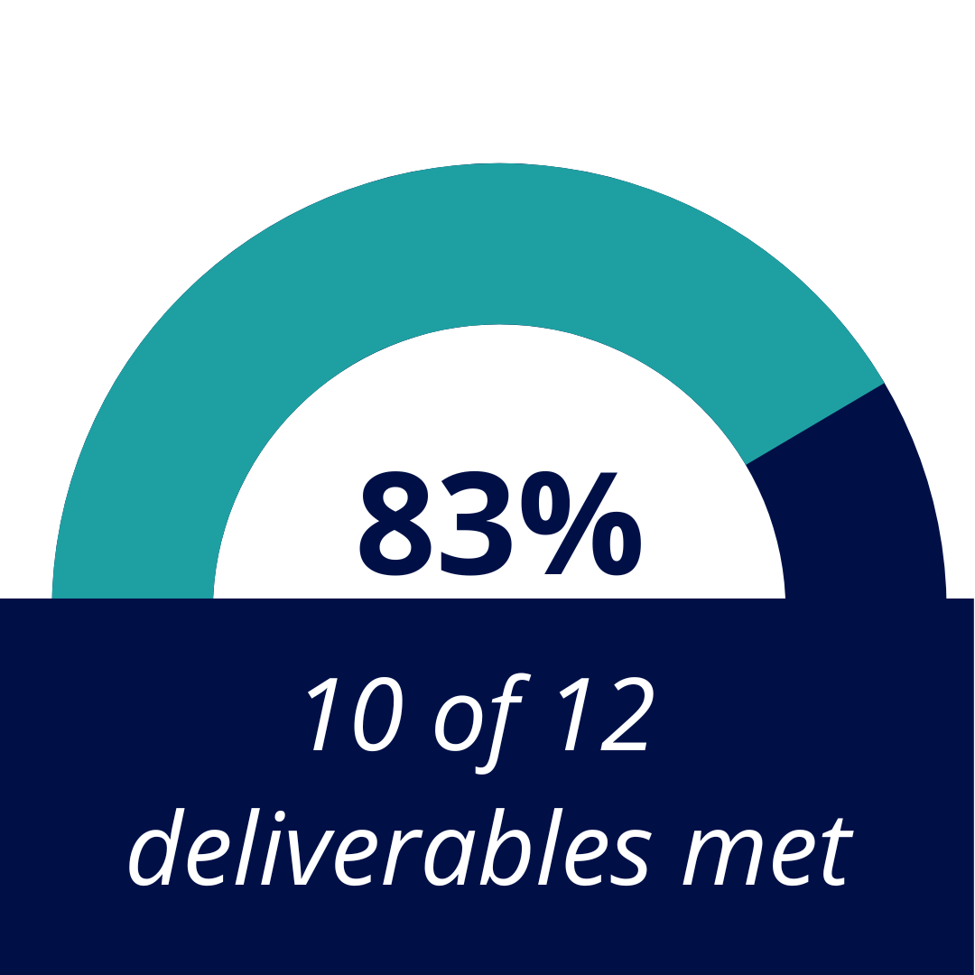
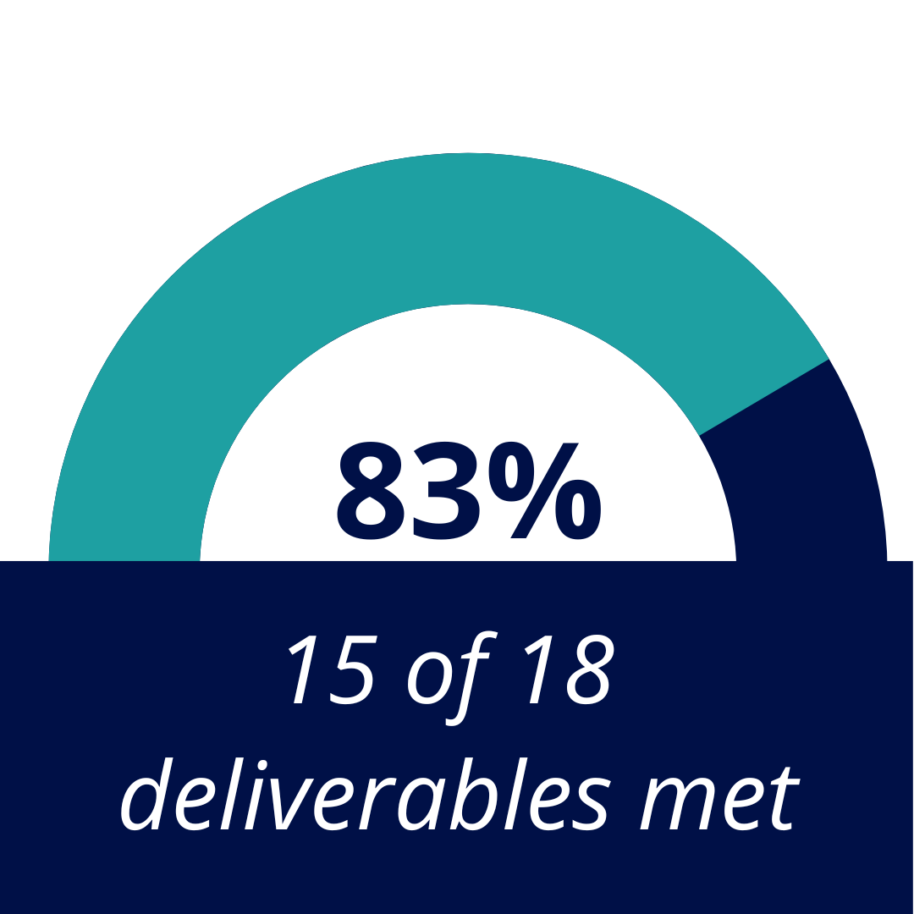
Commitment 1: Improve the Health and Well-Being of Louisianans with an Emphasis on Prevention
Assess Dental Coverage and Services for Adult Medicaid Enrollees to Improve Health Outcomes
Improve Access to Substance Use Disorder Treatment and the Quality of Care
Improve Care for Individuals with Serious Mental Illness
Notes:
INITIATIVE 1: Assess Dental Coverage and Services for Adult Medicaid Enrollees to Improve Health Outcomes (MET)
Goal 1: Conduct needs/costs assessment for comprehensive dental services for adult Medicaid members.
Goal 2: Develop comprehensive dental program for adults 21+ with intellectual/developmental disability waivers.
INITIATIVE 2: Improve Access to Substance Use Disorder Treatment and the Quality of Care (UNMET)
Goal 1: Increase use of evidence-based behavioral health treatment services.
Finalize licensure, accreditation
Begin providing services at two new OTPs
Goal 2: Expand hours at two OTP clinics to 24/7.
Two OTPs were selected and announced:
Centers for Behavioral Health, Shreveport, LA (Region 7)
BAART/BayMark Programs, North Shore, Hammond, LA (Region 9) — still recruiting and hiring staff to reach full weekend coverage in Hammond
Goal 3: Distribute 20,000 naloxone kits.
14,346 kits distributed in first three quarters of FY22 (72% to target) + 3,734 Medicaid Narcan prescription claims
INITIATIVE 3: Improve Care for Individuals with Serious Mental Illness (MET)
Goal 1: Roll out comprehensive crisis system of care, resulting in a 5% decrease in behavioral health ED visits for Medicaid members. *Crisis services were implemented in seven regions of the state. LDH is continuing to recruit and identify providers in regions without services.
Implement Mobile Crisis Intervention services — 17 crisis teams distributed by, and operating in, each LDH region
Implement Community Brief Crisis Support services — 10 programs working throughout the state, in each LDH region
Implement Behavioral Health Crisis Care Center — 10 programs working throughout the state, in each LDH region
Goal 2: Decrease potentially unnecessary hospitalizations to avoid unnecessary nursing home placements.
25,301 hospitalizations during SFY 2022 as of 8/31/2022, from 39,600 hospitalizations in FY20
Goal 3: Obtain 150 additional permanent supportive housing units or subsidies to house people with serious mental illness.
334 individuals were housed during FY22 using three different types of vouchers—NED, My Choice, and Continuum of Care

Slide 4
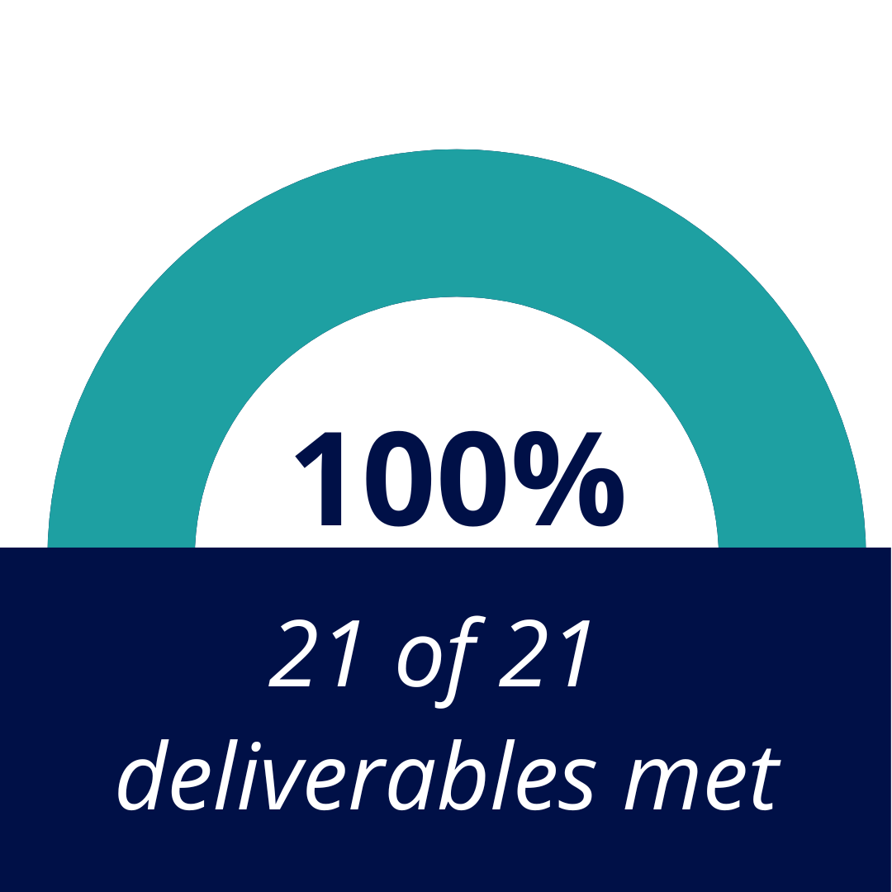
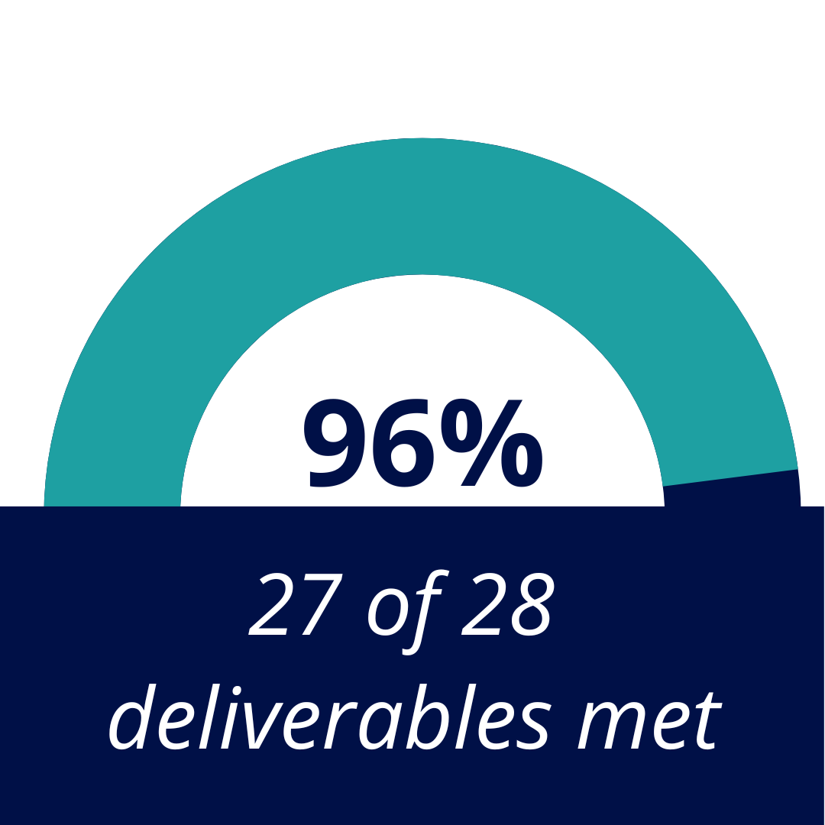
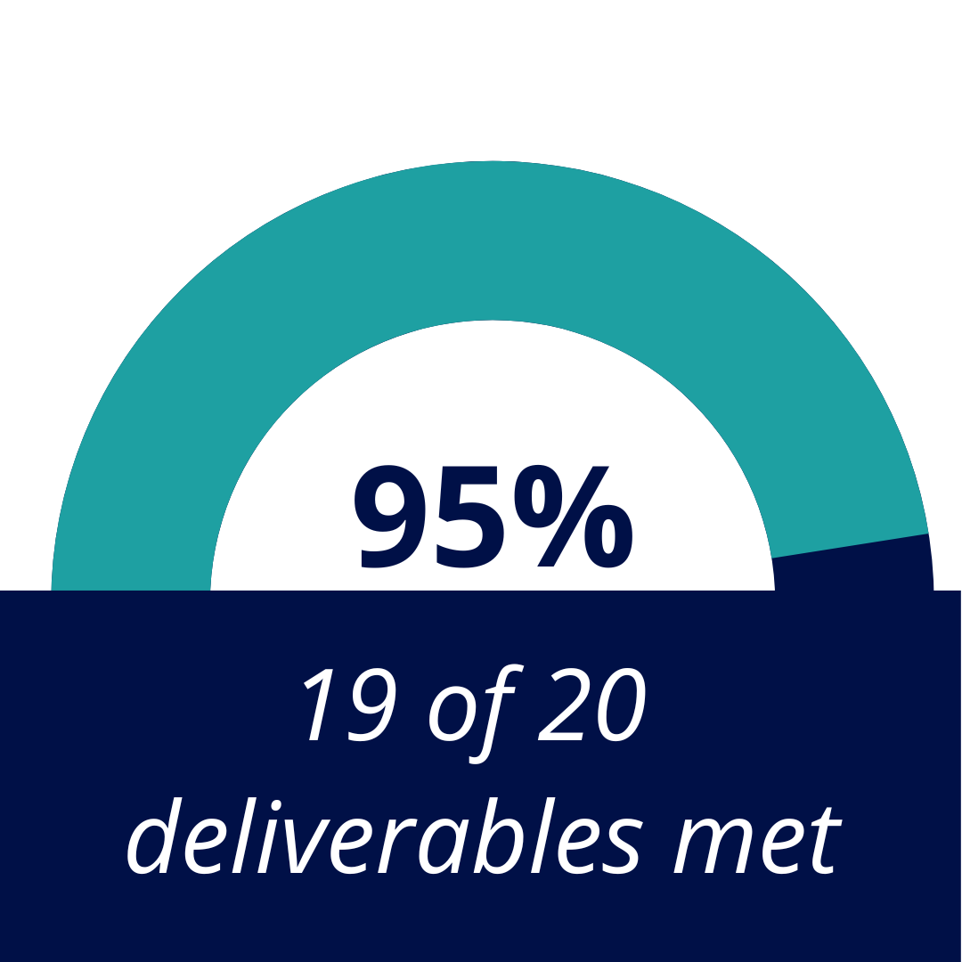
Commitment 1: Improve the Health and Well-Being of Louisianans with an Emphasis on Prevention
Improve Early Detection of Colorectal Cancer and Treatment of High Blood Pressure and Diabetes
Improve Health Outcomes from Pregnancy through Childhood
Increase and Strengthen Service Delivery for Vulnerable Residents
Notes:
INITIATIVE 4: Increase and Strengthen Service Delivery for Vulnerable Residents (MET)
Goal 1: Increase number of adult Medicaid members with controlled high blood pressure by 5,100 and with controlled diabetes by 2,300.
Increased # of adult Medicaid members with controlled high BP by 5,100 (from 63,724 to 68,824)
Increased # of Medicaid members with controlled diabetes by 2,300 (from 24,590 to 26,890)
Goal 2: Establish 12 new community-based blood pressure monitoring and diabetes prevention programs.
Established 16 community sites: 10 BP monitoring stations and 6 diabetes prevention programs
Goal 3: Increase overall colorectal cancer screening rates among adults ages 50-75 enrolled in Medicaid managed care plans and statewide by at least 2 percentage points.
Colorectal cancer screening in Medicaid managed care plans increased from 37% to 39%
Colorectal cancer screening statewide increased from 69% to 71%
LDH partnered with Mary Bird Perkins Cancer Center on 67 no-cost screening through MBP’s Prevention on the Go Program, screening 797 total participants
INITIATIVE 5: Improve Health Outcomes from Pregnancy through Childhood (UNMET)
Goal 1: Launch and create sustainability for four statewide initiatives to address the leading clinical contributors to preventable maternal deaths.
28.4% (final data from CY2021); among facilities reporting in CY2022, NTSV Cesarean delivery rates (measured using The Joint Commission’s PC-02) are 27.5% in Q1 2022, and 27.3% in Q2 2022
Goal 2: Enact three substantive policy changes to strengthen the state’s maternal systems of care.
Goal 3: Implement four policy and programmatic changes to increase access to maternal care services.
231 women enrolled in enhanced care coordination services thru MCOs + GRACE (Women’s Hospital)
Goal 4: Improve systems that support breast milk as first food to increase breastfeeding initiation among Medicaid beneficiaries in Louisiana by 8%. *Data will be available December 2022-March 2023.
For women enrolled in WIC, Louisiana has seen an increase in overall rates of BF (% postpartum women that are BF) and in exclusivity (% of women fully BF) over the course of FY22
Goal 5: Increase the number of all mothers breastfeeding their infants at eight weeks of life by 4%. *Data will be available December 2022-March 2023.
Adequate WIC Breastfeeding Peer Counselors — 75% coverage across all regions
16 birthing facilities awarded under The Gift 3.0
Goal 6: Increase provision of preventive services in 4 areas of child health: developmental screening, immunizations, oral health, and Adverse Childhood Experiences.
Restore the referral rate to early intervention services following the 20% decreases experienced as a result of the impact of COVID-19 and hurricanes; 11,908 referrals of 12,590 (95% to target)
Increased number of Medicaid-insured children ages 0-3 who receive a developmental screening by 4,300 (5%) — 43,325 as of 9/30; final data available in November
Increased provision of fluoride varnish in the medical home by 13,781; surpassed target of 500; final data available in November 2022
INITIATIVE 6: Increase and Strengthen Service Delivery for Vulnerable Residents (UNMET)
Goal 1: Expand eligibility for Medicaid home- and community-based services to more children with disabilities.
Of 837 applications, 311 were approved and 79 were denied; average time to process application: 90 days
Goal 2: Reduce turnover rate of direct support professionals by 2.5% and increase number of new direct support professionals by 5%.
Increased number of new direct support professionals by 5% in a 1-year period
Baseline: 29,250 (April 2020)
BP target: 30,713
29,375 (April 2022); 29,265 (June 2022)
OCDD exceeded identified target for OCDD and OAAS combined for decreased turnover of new direct support professionals, from 60.1% (4/26/21) to 53.9% (4/26/22)
Goal 3: Open a new Program for All Inclusive Care for the Elderly (PACE) site.
Received approval for 1 new site but it has not yet opened
Did not meet deliverable of increasing total PACE enrollment to 630 (final FY22 enrollment: 412)

Slide 5
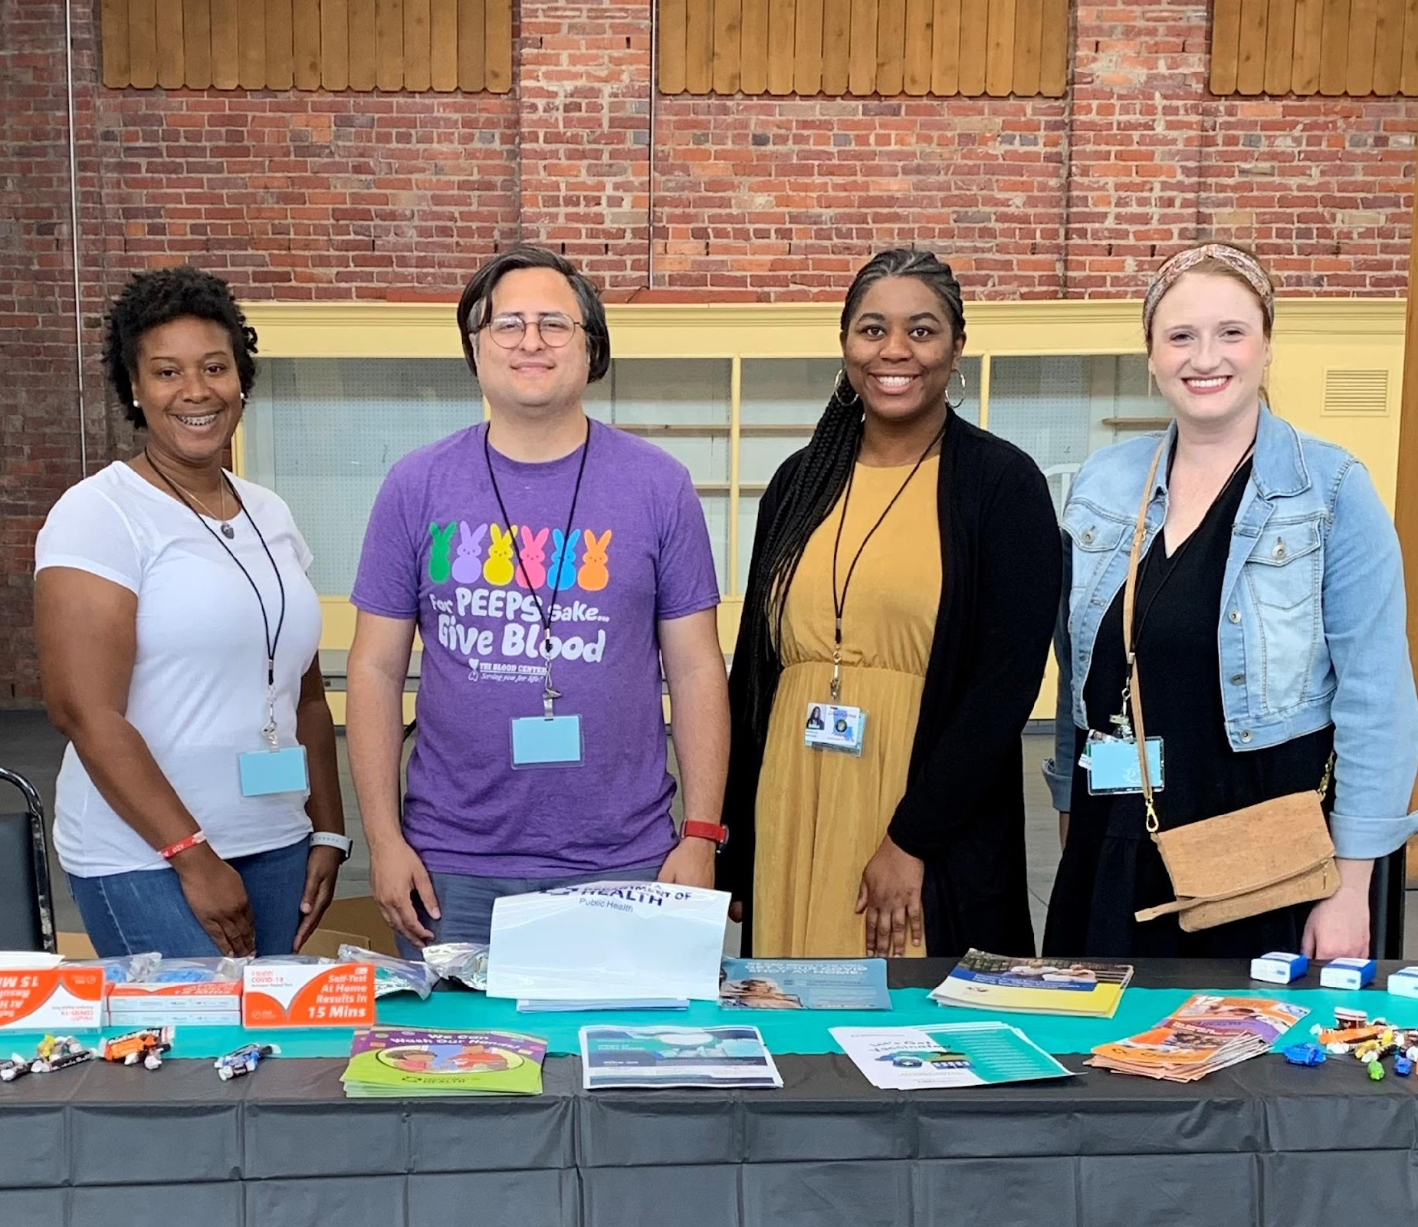
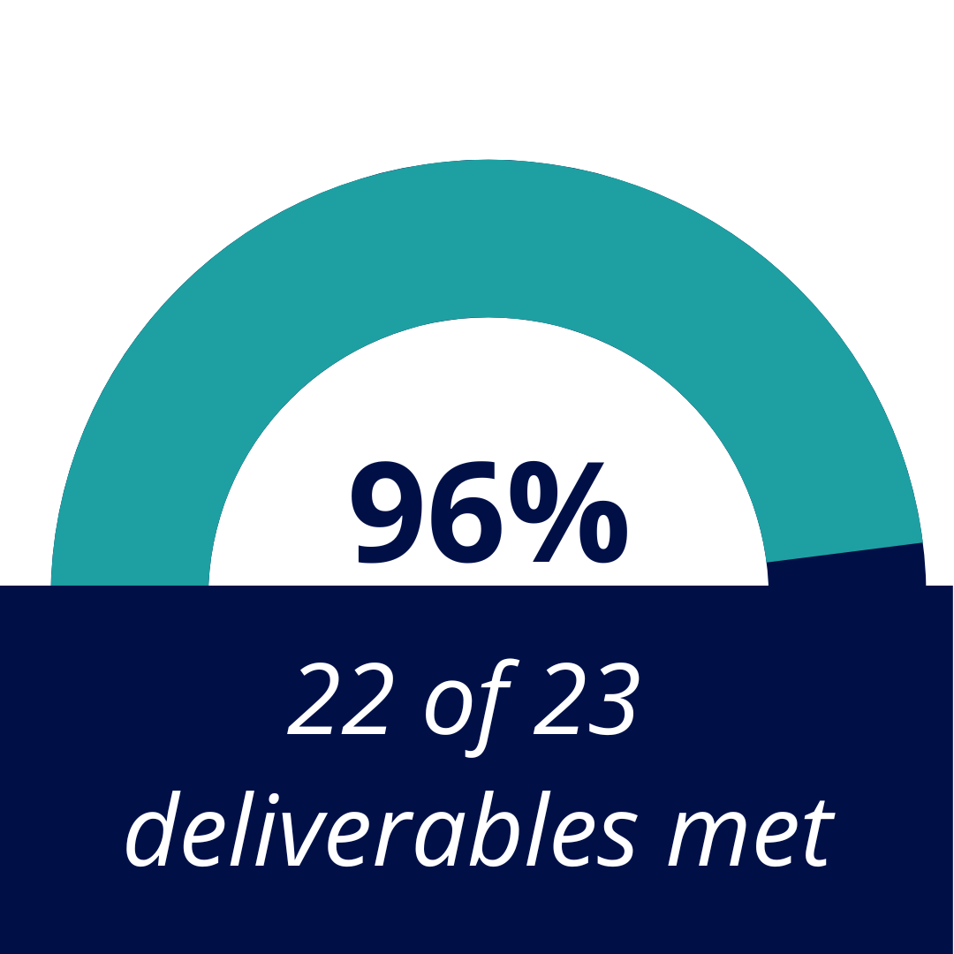
Commitment 2: Reshape #TeamLDH Culture
Advance Equity, Diversity, and Inclusion within LDH
Reshape #TeamLDH Culture, Recruitment, and Retention
Notes:
INITIATIVE 7: Advance Equity, Diversity, and Inclusion within LDH
Goal 1: Advance diversity throughout all levels of the LDH workforce.
Conducted assessment of LDH employee demographic data to identify any gaps between internal workforce demographic data and statewide demographic data
Goal 2: Foster and advance diverse representation through healthcare governance.
Developed policy and tools to ensure staff are intentional about ensuring diversity among the members of our boards and commissions
INITIATIVE 8: Reshape #TeamLDH Culture, Recruitment, and Retention
Goal 1: Decrease the employee turnover rate by 1% from FY20 to FY22.
Final data forthcoming
Goal 2: Implement a streamlined hiring process that reduces the time from posting to hiring a position to an average of 60 days by February 2022. This represents a decrease from an average of 90 days in FY21.
Goal 3: Develop and implement a formal succession planning program at LDH that results in the creation of succession plans for 10% of the positions throughout LDH.
60 succession plans completed
Goal 4: Develop and implement a departmental leadership training program that identifies emerging leaders by June 2022.
Established program; first cohort will be in Spring 2023

Slide 6
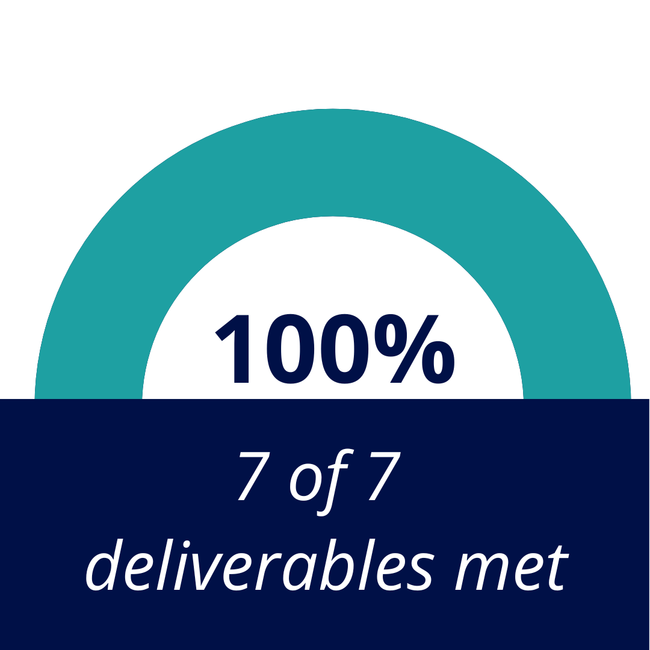
Commitment 3: Enhance Customer Service, Partnerships, and Community Relations
Forge New Strategic Partnerships with Public Universities
Improve the Sustainability of Public Water Systems
Leverage Community Partnerships to Improve Participation in LDH Programs and Improve Program Design
Notes:
INITIATIVE 9: Forge New Strategic Partnerships with Public Universities (MET)
Goal 1: Establish university partnerships to conduct projects that identify and address three challenges or opportunities in LDH.
Established Public University Partnership Program (PUPP); awarded funding to LSU Health Sciences Center and Pennington Biomedical Research Center
INITIATIVE 10: Improve the Sustainability of Public Water Systems (MET)
Goal 1: Issue annual letter grades for water systems per Act 98 of the 2021 Regular Session.
Plan to begin issuing letter grades in 1st quarter of 2023
Estimate approximately 15-20% of systems may receive a D or F
Goal 2: Develop a plan to prioritize funding for consolidation projects and infrastructure improvements.
INITIATIVE 11: Leverage Community Partnerships to Improve Participation in LDH Programs and Improve Program Design (MET)
Goal 1: Develop an LDH Community Engagement Toolkit
Goal 2: Use the toolkit to introduce LDH to the community while assessing opportunities and challenges.

Slide 7
Commitment 4: Promote Transparency, Accountability, and Compliance
Develop and Implement a Comprehensive Medicaid Provider Rate Review Process
Improve LDH Compliance with State, Federal, and Agency Requirements
Notes:
INITIATIVE 14: Develop and Implement a Comprehensive Medicaid Provider Rate Review Process (MET)
Goal: Establish an annual rate review process that compares current provider rates across Medicaid, the southern average, the national average, Medicare rates, and commercial rates (if available) for all provider types on a staggered three-year cycle to allow for resourcing.
INITIATIVE 15: Develop Sustainable, Equitable, and Comprehensive Supplemental Payment Systems (MET)
Goal: Develop supplemental payment systems that incorporate broad stakeholder feedback and receive approval from the Centers for Medicare and Medicaid Services (CMS).
Launched new payment model that:
Increases hospital supplemental payments
Prioritizes maintaining adequate funding for safety-net hospitals without requiring additional state general funds
Creates more uniform guidelines and stability for hospital payments
INITIATIVE 16: Improve LDH Compliance with State, Federal, and Agency Requirements (MET)
Goal 1: Improve internal oversight of Medicaid providers through predictive analytics risk models, resulting in a 30% increase in cases opened on Medicaid high-risk provider types.
Cases opened on Medicaid 5 high-risk provider types: 112% of goal
Goal 2: Improve internal oversight of Medicaid recipient fraud through predictive analytics risk models, resulting in a 25% increase in recipient fraud investigations cases opened.
Recipient fraud investigations opened: 102% of goal
Goal 3: Increase transparency, accountability, and compliance in Medicaid eligibility determinations resulting in a decrease in the case review error rate to 6% or less.
Decreased error rate to 5%, exceeding goal of 6% or less
Goal 4: Improve TPL cost avoidance and recovery capabilities, resulting in a 5% increase in total cost avoidance savings and recoveries.
Increase in total cost avoidance savings: $798,295,007.39, surpassing goal of $579,373,119.18

Slide 8
FY 2023 LDH Business Plan | Invest: Teaming up for a Stronger LDH and a Healthier Louisiana
OUR COMMITMENTS:
Improve Health and Well-Being across the Life Span of Louisianans
Support Vulnerable and Underserved Populations
Invest in and Empower #TeamLDH
Improve Performance, Accountability, and Compliance
Strengthen Customer Service, Partnerships, and Community Relations
THESE COMMITMENTS ENCOMPASS:
18 initiatives
45 goals
253 deliverables
Click HERE to view full FY23 Business Plan
Notes:
Invest: Teaming up for a Stronger LDH and a Healthier Louisiana is our framework for making improvements in key areas during Fiscal Year 2023 (July 1, 2022-June 30, 2023).
It is also a commitment to the public, allowing for accountability and a greater understanding of the work of the Department.
In setting priorities and creating strategies, we gathered feedback from LDH team members, legislators, stakeholders, and members of the public. We listened to those we serve.
Our new plan builds on progress made in the FY22 plan. LDH will continue our work in:
Behavioral health by further expanding crisis services and making them available to adolescents
Improving maternal and child health by increasing breastfeeding rates and developing a state plan to address adverse childhood experiences and trauma
Identifying colorectal cancer early by partnership with community leaders and removing barriers to screening
In the spirit of our fourth commitment, we will report on our outcomes and launch our next business plan at the end of the first quarter of FY24.

Slide 9
Commitment 1: Improve Health and Well-Being across the Lifespan of Louisianans Initiative 1: Improve Health Outcomes in Pregnancy and through Childhood
Goal 1: Increase breastfeeding rates.
Goal 2: Address the effects of Adverse Childhood Experiences (ACEs) and trauma.
Notes:
INITIATIVE 1 (OPH and Medicaid): Improve Health Outcomes in Pregnancy and through Childhood
Goal 1 (Medicaid): Increase breastfeeding rates through implementation of two policy changes, and increased prenatal and infant participation in the WIC program.
Promote WIC pre-screening tool to potentially enroll eligible women and infants in LA WIC
Implement data-sharing with Supplemental Nutrition Assistance Program (SNAP) and Medicaid to expand enrollment
Partner with birthing facilities
Bureau of Nutrition Services (BONS) to promote breast milk through peer counselors
Goal 2 (OPH): Develop a state plan across Louisiana’s child- and family-serving systems to prevent, recognize, and address the effects of Adverse Childhood Experiences (ACEs) and trauma.
Develop work plan and budget for convening collaborators, steering community, and listening sessions
INITIATIVE 1 WRAP-UP: Addressing gaps in care is key: Outpatient breastfeeding support, especially among the Medicaid population, is critical to raise breastfeeding rates, and a statewide trauma-informed plan will help set priorities and inform action around addressing the drivers of ACEs and childhood trauma.

Slide 10
Commitment 1: Improve Health and Well-Being across the Lifespan of Louisianans Initiative 2: Improve Prevention, Early Detection, and Treatment of Chronic Diseases
Goal 1: Increase colorectal cancer (CRC) screening rates.
Goal 2: Increase the number of participants screened for cardiovascular disease, blood pressure, and diabetes.
Goal 3: Increase the use of best practices for the early detection of cardiovascular disease.
Goal 4: Increase the number of Louisiana childcare centers and schools engaged in childhood obesity prevention activities.
Notes:
INITIATIVE 2 (Medicaid, OPH and Policy & QI): Improve Prevention, Early Detection, and Treatment of Chronic Diseases
Goal 1 (Policy & QI): Increase colorectal cancer (CRC) screening rates among men and women ages 45-75 enrolled in Medicaid managed care plans and statewide in Louisiana by at least 2 percentage points.
Continue partnerships with MCOs, Mary Bird Perkins and Ochsner Health
Fund a 12-month learning initiative with primary care practices for skills-based learning
Goal 2 (OPH): Increase the number of participants screened for cardiovascular disease, blood pressure, and diabetes at community-based events.
Well-Ahead will continue to work with community-based blood pressure monitoring and diabetes prevention programs to increase # of individuals screened
Support community orgs and MCOs with health events to increase screenings and awareness of hypertension
Goal 3 (OPH): Increase the use of best practices for the early detection of cardiovascular disease by rural health providers by 20%.
Assist Federally Qualified Health Centers (FQHCs) and Rural Health Clinics through education and quality improvement strategies to improve percentage of controlled hypertensive population
Assist in achieving American Medical Association’s Target: BP Gold recognition

Slide 11
Commitment 1: Improve Health and Well-Being across the Lifespan of Louisianans Initiative 2: Improve Prevention, Early Detection, and Treatment of Chronic Diseases
Goal 5: Increase access to healthier food options for Louisiana residents in underserved communities.
Goal 6: Increase coverage of tobacco cessation counseling.
Goal 7: Enroll children in non-clinical asthma management services.
Notes:
INITIATIVE 2 (Medicaid, OPH and Policy & QI): Improve Prevention, Early Detection, and Treatment of Chronic Diseases
Goal 1 (Policy & QI): Increase colorectal cancer (CRC) screening rates among men and women ages 45-75 enrolled in Medicaid managed care plans and statewide in Louisiana by at least 2 percentage points.
Continue partnerships with MCOs, Mary Bird Perkins and Ochsner Health
Fund a 12-month learning initiative with primary care practices for skills-based learning
Goal 2 (OPH): Increase the number of participants screened for cardiovascular disease, blood pressure, and diabetes at community-based events.
Well-Ahead will continue to work with community-based blood pressure monitoring and diabetes prevention programs to increase # of individuals screened
Support community orgs and MCOs with health events to increase screenings and awareness of hypertension
Goal 3 (OPH): Increase the use of best practices for the early detection of cardiovascular disease by rural health providers by 20%.
Assist Federally Qualified Health Centers (FQHCs) and Rural Health Clinics through education and quality improvement strategies to improve percentage of controlled hypertensive population
Assist in achieving American Medical Association’s Target: BP Gold recognition

Slide 12
Commitment 1: Improve Health and Well-Being across the Lifespan of Louisianans Initiative 3: Increase Availability of Behavioral Health Services
Goal 1: Increase access to crisis call services for individuals in suicidal crisis or emotional distress.
Goal 2: Expand the behavioral health system’s capacity to meet the needs of people with mental illness.
Goal 3: Conceptualize a system to introduce child and adolescent crisis services to Medicaid members.
Notes:
INITIATIVE 3 (OBH): Increase Availability of Behavioral Health Services
Goal 1 (OBH): Increase access to crisis call services for individuals in suicidal crisis or emotional distress — maintaining a statewide, in-state answer rate of 90%.
Paid media campaign focusing on vulnerable populations:
LGBTQ+
Historically marginalized
Black, Indigenous and People of Color (BIPOC)
Youth
Suicide attempt and loss survivors
Goal 2 (OBH): Expand the behavioral health system’s capacity to meet the needs of people with mental illness by expanding bed availability.
Eastern Louisiana Mental Health Services (ELMHS) will secure agreements with providers and expand psychiatric hospital placement options
Goal 3 (OBH): Conceptualize a system to introduce child and adolescent crisis services to Medicaid members including a mechanism to select qualified organizations to act as early adopters.
OBH and Medicaid preparing funding request to support child and adolescent crisis services in early adopter regions by FY2024
INITIATIVE 3 WRAP-UP: Focusing on people who are in crisis and who need long-term psychiatric care will help address longstanding mental health needs in LA.

Slide 13
Commitment 1: Improve Health and Well-Being across the Lifespan of Louisianans Initiative 4: Increase Access to Dental Services for Adults with Developmental Disabilities
Goal 1: Ensure 20 dental providers are serving those living with developmental disabilities.
Goal 2: Increase the percentage of recipients enrolled in the Adult Waiver Dental Program.
Notes:
INITIATIVE 4 (Medicaid and OCDD): Increase Access to Dental Services for Adults with Developmental Disabilities
Goal 1 (Medicaid and OCDD): Ensure a minimum of 20 dental providers are serving those living with developmental disabilities.
Partner with LA Dental Association to schedule two training seminars hosted by experienced providers
Goal 2 (Medicaid and OCDD): Increase the percentage of recipients enrolled in the Adult Waiver Dental Program who receive a preventive or non-preventive dental service.
Medicaid to partner with Dental Benefit Plan Managers to raise awareness
OCDD identifies partners to provide outreach support and training to encourage improved dental care at home

Slide 14
Commitment 2: Support Vulnerable and Underserved Populations Initiative 5: Improve Systems to Support People Living with Sickle Cell Disease
Goal 1: Complete the foundational assessment and engagement activities needed to develop the state sickle cell registry.
Notes:
INITIATIVE 5 (OPH): Improve Systems to Support People Living with Sickle Cell Disease
Goal 1 (OPH): Complete the foundational assessment and engagement activities needed to develop the state sickle cell registry.
Statewide sickle cell public information campaign
Report preliminary findings for comprehensive public health reporting and monitoring for SCD
Report recommendations for reporting requirements, data uses and anticipated technical requirements for the sickle cell registry.
INITIATIVE 5 WRAP-UP: The SCD Registry will eventually provide greater visibility of the extent of the disease and help reach this vulnerable population and understand how to better coordinate care and provide targeted provider resources.

Slide 15
Commitment 2: Support Vulnerable and Underserved Populations Initiative 6: Increase and Strengthen Service Delivery for Vulnerable Residents
Goal 1: Increase the Community Choices Waiver response rate.
Goal 2: Offer the Community Choices Waiver to those waiting with no other Office of Aging and Adult Services (OAAS) support.
Goal 3: Reduce turnover rate of OAAS direct support professionals.
Goal 4: Reduce turnover rate of Office for Citizens with Developmental Disabilities (OCDD) direct support professionals.
Goal 5: Broaden the use of technology with remote support in OCDD home- and community-based waivers.
Notes:
INITIATIVE 6 (OAAS and OCDD): Increase and Strengthen Service Delivery for Vulnerable Residents
Goal 1 (OAAS): Increase the Community Choices Waiver response rate by 5%.
Goal 2 (OAAS): Offer the Community Choices Waiver within 60 days of the date of request to those waiting with no other Office of Aging and Adult Services (OAAS) home- and community-based supports
Focus on improving speed of waiver process from initial request for services to approval for services
Goal 3 (OAAS): Reduce turnover rate of OAAS direct support professionals by 2.5% by the end of FY23.
OAAS will use ARPA funding to increase rates to direct service workers and OAAS and OCDD will partner to study reasons for staffing shortages
INITIATIVE 6 (OAAS and OCDD): Increase and Strengthen Service Delivery for Vulnerable Residents
Goal 4 (OCDD): Reduce turnover rate of Office for Citizens with Developmental Disabilities (OCDD) direct support professionals by 2.5% by the end of FY23.
OAAS and OCDD will partner to study reasons for staffing shortages
Goal 5 (OCDD): Broaden opportunities for community involvement and increased independence through the use of technology with remote support in OCDD home- and community-based waivers.
OCDD will identify providers to offer services and help stakeholders and the general public understand how these services can be used most effectively.
OCDD will conduct focus groups to discuss barriers; implement recruitment strategies to build provider network for services; and roll out campaign focused on increasing access
INITIATIVE 6 WRAP-UP: This initiative seeks to address long-standing barriers to delivering core services for vulnerable residents and ensure the Department is responsive to those seeking the Community Choice waiver.

Slide 16
Commitment 2: Support Vulnerable and Underserved Populations Initiative 7: Protect the Health, Safety, and Welfare of Nursing Home Residents in Louisiana
Goal 1: Ensure review and approval of emergency preparedness plans.
Goal 2: Provide for the efficient submission, review, and approval/denial of nursing home emergency preparedness plans.
Notes:
INITIATIVE 7 (LARC – Health Standards): Protect the Health, Safety, and Welfare of Nursing Home Residents in Louisiana
Goal 1 (LARC – Health Standards): Ensure review and approval of emergency preparedness plans submitted to the Department.
Team approach to evaluating nursing homes’ (NH) emergency preparedness plans
Partner agencies:
Local OEPs
Governor’s Office of Homeland Security and Emergency Preparedness (GOHSEP)
Department of Transportation and Development (DOTD)
Louisiana Emergency Response Network (LERN)
Office of the State Fire Marshal (OSFM)
Partners review each plan and any unlicensed facilities to ensure health, safety and welfare of NH residents
Goal 2 (LARC – Health Standards): Provide for the efficient submission, review, and approval/denial of nursing home emergency preparedness plans.
Electronic submission of NH emergency preparedness plans, streamlining approval process and allowing for tracking of plans throughout approval process
INITIATIVE 7 WRAP-UP: Ensuring the health and safety of nursing home residents during disasters is a top priority. This initiative provides a framework for doing that through a team-focused review process.

Slide 17
Commitment 2: Support Vulnerable and Underserved Populations Initiative 8: Improve the Sustainability of Public Water Systems
Goal 1: Utilize Bipartisan Infrastructure Law funding to continue to stabilize the state’s water infrastructure.
Notes:
INITIATIVE 8 (Engineering): Improve the Sustainability of Public Water Systems
Goal 1 (OPH: Engineering): Utilize Bipartisan Infrastructure Law funding to continue to stabilize the state’s water infrastructure.
Assist water systems in loan-closing process, including development of system improvement plans
Help obtain rate study
Engineering contract review and approval
Approval of environmental information documents
INITIATIVE 8 WRAP-UP: There are ample resources available to water systems, but they will need LDH's technical assistance to get their projects ready to receive funding.

Slide 18
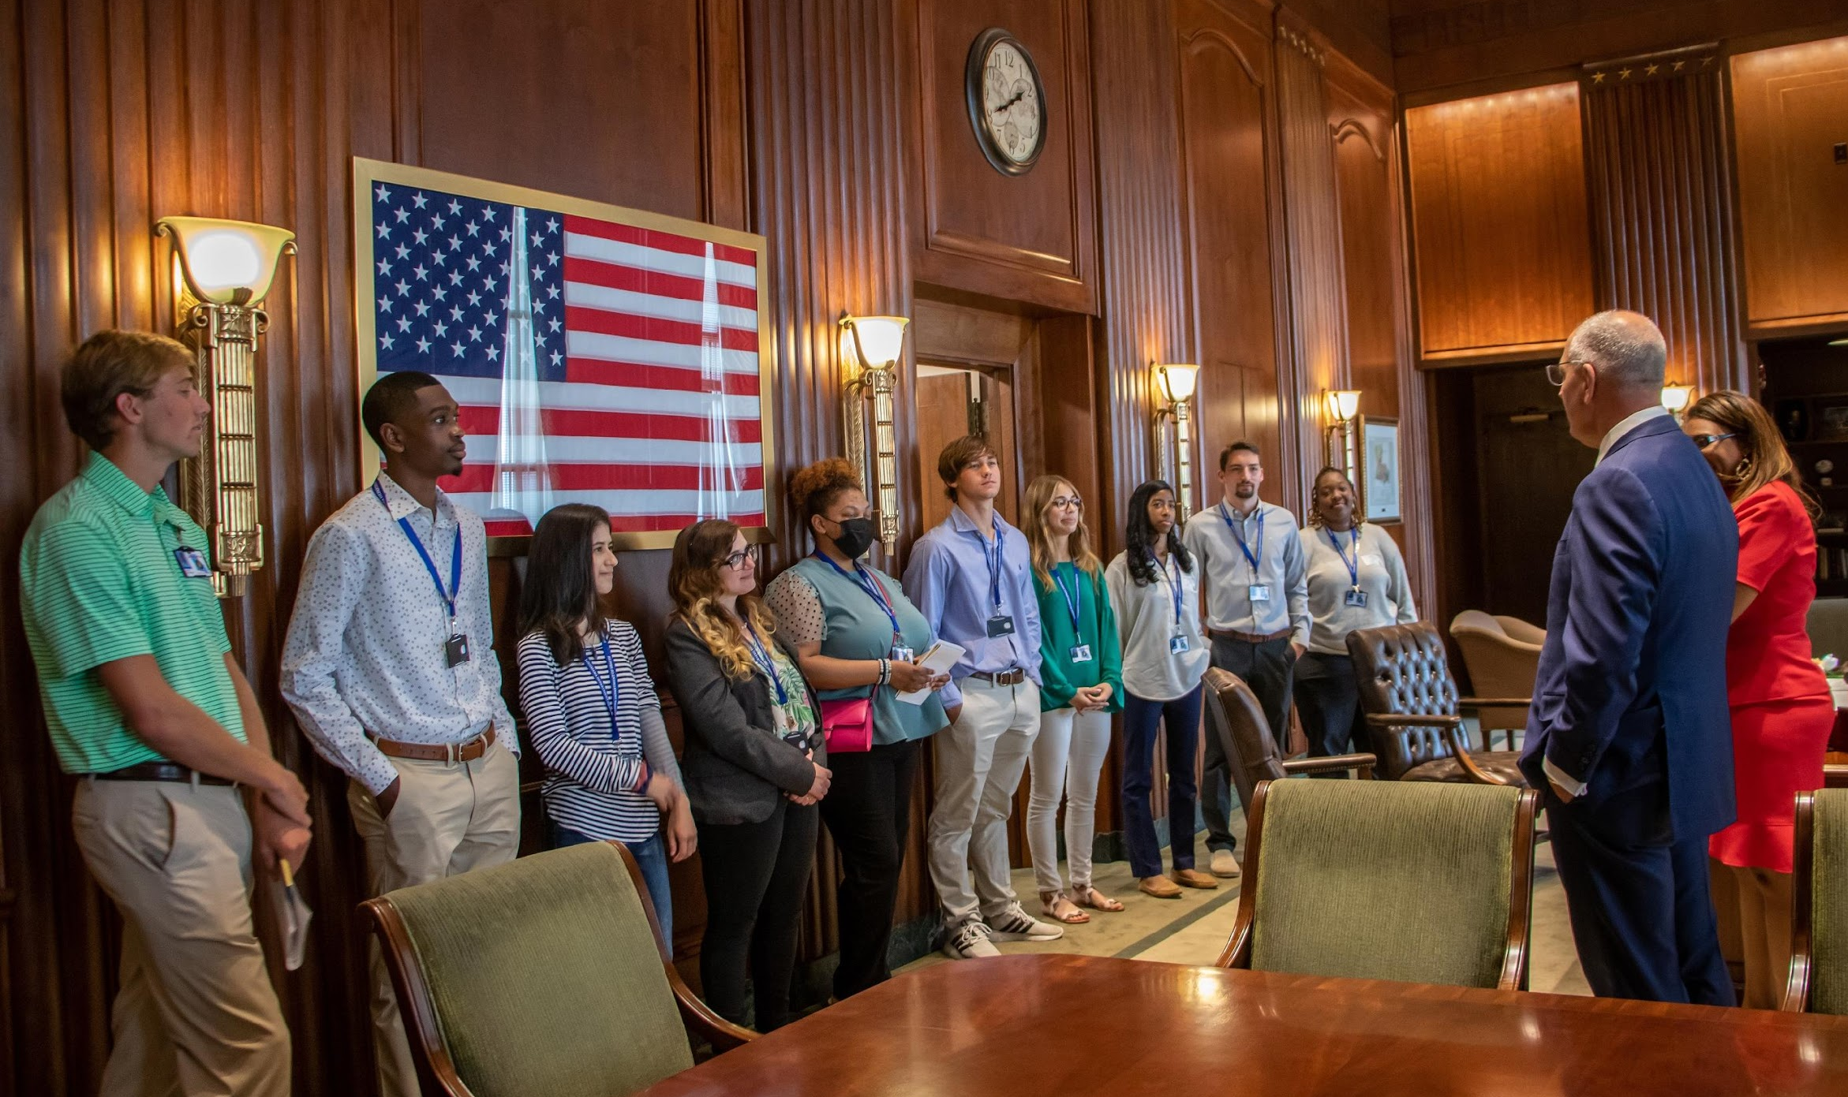
Commitment 3: Invest in and Empower #TeamLDH Initiative 9: Improve #TeamLDH Culture, Recruitment, and Retention
Goal 1: Continue the Executive Internship Cohort.
Goal 2: Build succession plans for 20% of critical positions within LDH.
Notes:
INITIATIVE 9 (Human Resources): Improve #TeamLDH Culture, Recruitment, and Retention
Goal 1 (Human Resources): Continue the Executive Internship Cohort Program in FY23 to provide current college students with real-time industry experience, visibility, and exposure to various aspects of LDH.
Attend college career fairs and host LDH career days
Convert 10% of summer interns to full-time employees
Goal 2 (Human Resources): Build succession plans for 20% of critical positions within LDH.
HR will expand the formal succession planning program
HR to pilot a quarterly talent review, identifying key roles, skill sets required and future potential across LDH

Slide 19
Commitment 3: Invest in and Empower #TeamLDH
Initiative 10: Expand Workforce Development Training Program
Goal 1: Expand the Workforce Development Training Program throughout Medicaid.
Goal 2: Decrease vacancies for professional-level direct support positions in LDH’s 24-hour state facilities.
Initiative 11: Establish an LDH Annual Quality Improvement Process
Goal 1: Develop a QI Plan and processes for continuous QI to inform LDH policy development.
Notes:
INITIATIVE 10 (Medicaid and LDH Facilities): Expand Workforce Development Training Program
Goal 1 (Medicaid): Expand the Workforce Development Training Program throughout Medicaid by hiring and training an additional 100 individuals.
Recruitment strategies:
Participate in outreach events (e.g., job fairs, community events/festivals)
Visit nontraditional areas (e.g., rural shopping centers)
Goal 2 (LDH Facilities): Decrease vacancies for difficult-to-fill professional-level direct support positions in LDH’s 24-hour state facilities in FY23.
24-hour facilities partner with institutes of higher education to:
Expose students to clinical opportunities
Engage with local communities of the facilities
INITIATIVE 10 WRAP-UP: Using recruitment strategies effectively will help fill many positions that have either had high turnover or are difficult to fill, especially at 24-hour state facilities.
INITIATIVE 11 ( Policy & QI): Establish an LDH Annual Quality (QI) Improvement Process
Goal 1 (Policy & QI): Develop a QI Plan and processes for continuous QI to inform LDH policy development.
Scope of QI activities
Metrics to measure progress
Review process for previous QI activities
INITIATIVE 11 WRAP-UP: A quality improvement approach to long-term planning would help LDH have improved access to data and evaluate initiatives using a metrics-based approach.

Slide 20
Commitment 4: Improve Performance, Accountability, and Compliance
Initiative 12: Develop and implement a process to reduce external audit findings.
Goal 1: Establish a successful approach to reducing external audit findings.
Initiative 13: Advance Prevention of Medicaid Fraud and Waste
Goal 1: Improve the internal oversight of five provider types.
Goal 2: Improve the internal oversight of beneficiary fraud.
Initiative 14: Develop sustainable, equitable, and comprehensive Supplemental Payment Systems
Notes:
INITIATIVE 13 (LARC – Program Integrity): Advance Prevention of Medicaid Fraud and Waste
Goal 1 (LARC – Program Integrity): Improve the internal oversight of five provider types through the development of predictive analytics risk models, using an evidence-based, process-driven, algorithm-development framework, resulting in a 30% increase in cases opened on the five selected Medicaid provider types.
Goal 2 (LARC – Program Integrity): Improve the internal oversight of beneficiary fraud through the development of predictive analytics risk models to search across all of the approximately 1.8 million recipients, using an evidence-based, process-driven, algorithm-development framework, resulting in a 10% increase in individual recipient data mining case reviews opened, or 1,375 individual recipients data mining case reviews opened in FY23.
INITIATIVE 13 WRAP-UP: Implementing this hyper-focused methodology will concentrate resources to achieve greater outcomes in the prevention, detection, and recovery of fraud, waste, and abuse in the Medicaid program.
INITIATIVE 14 (Medicaid): Develop Sustainable, Equitable, and Comprehensive Supplemental Payment Systems
Goal 1 (Medicaid): Develop a replacement reimbursement method for Ambulance Full Medicaid Pricing (FMP) developed with input and feedback from stakeholders and legislative leadership for CMS review by March 2023.
Goal 2 (Medicaid): Develop a replacement reimbursement method for Dental FMP for dental providers with input and feedback from stakeholders and legislative leadership for CMS review to ensure dental access for Louisiana residents by March 2023.
Goal 3 (Medicaid): Develop a managed care payment system for physicians that is developed with input and feedback from stakeholders and legislative leadership for CMS review by March 2023.

Slide 21
Commitment 5: Strengthen Customer Service, Partnerships, and Community Relations Initiative 15: Establish the Office of Women’s Health and Community Health
Goal 1: Develop and operationalize OWHCH.
Notes:
INITIATIVE 15 (OWHCH Staff): Establish the Office of Women’s Health and Community Health
Goal 1 (OWHCH Staff): Develop and operationalize OWHCH.
Gather information from other states’ Offices of Women’s Health, U.S. Department of Health and Human Service regional Women’s Health Analyst
Assessment of relevant data sources within LDH that will inform OWHCH’s program priorities
ID key women’s stakeholders across LA, establish OWHCH advisory committee and build community partnerships
Plan and host town hall meetings across LA
Strengthen community partnerships
Develop 1st annual report to submit to LDH leadership, legislators, Governor

Slide 22
Commitment 5: Strengthen Customer Service, Partnerships, and Community Relations Initiative 16: Build Statewide Capacity to Engage in Systemic Health Equity Work
Goal 1: Develop and implement an EDI/HE framework.
Goal 2: Integrate expectations for EDI/HE into performance expectations and measures.
Goal 3: Develop and deliver an EDI/HE competency training.
Notes:
INITIATIVE 16 (Training, HR, and BCPHE): Build Statewide Capacity to Engage in Systemic Health Equity Work
Goal 1 (Training, HR, and BCPHE): Develop and implement an EDI/HE (equity, diversity, and inclusion/health equity) framework.
Develop and align competencies to stakeholders to discuss meaning/behaviors associated with EDI/HE at LDH
ID behaviors with competencies
Make recommendations
Goal 2 (Training, HR, and BCPHE): Integrate expectations for EDI/HE into team members’ performance expectations and measures.
Includes LDH policy and annual performance review procedures
Goal 3 (Training, HR, and BCPHE): Develop and deliver an EDI/HE competency training session for LDH team members and managers.
Pilot will eventually include required training for team members

Slide 23
Commitment 5: Strengthen Customer Service, Partnerships, and Community Relations Initiative 17: Strengthen, Expand, and Diversify Louisiana’s Healthcare Workforce
Goal 1: Increase availability of office-based opioid treatment (OBOT).
Goal 2: Recruit new students into the Well-Ahead Louisiana Rural Health Scholars Program.
Goal 3: Establish the Rural Physician Loan Repayment Program.
Notes:
INITIATIVE 17 (OPH and OBH): Strengthen, Expand, and Diversify Louisiana’s Healthcare Workforce
Goal 1 (OBH): Increase availability of office-based opioid treatment (OBOT) programs within physician or prescriber offices throughout the state.
Recruit 10 new OBOT providers; goal of 37 statewide with focus on hot spots
Partner with LSU Health Sciences Center to develop/execute campaign to recruit more OBOTs
Goal 2 (OPH): Recruit 20 new healthcare students into the Well-Ahead Louisiana Rural Health Scholars Program in healthcare provider shortage areas throughout the state.
Offers 3rd and 4th year med students opportunity to complete 180-hour rotation in a rural healthcare facility
Participating students get stipend and assistance with job placement
Goal 3 (OPH): Establish the Rural Physician Loan Repayment Program and enroll 15 providers by the end of FY23.
Repayment of loans and salary for up to 15 primary care clinicians in exchange for providing healthcare services in a rural area
Well-Ahead working with partners to promote recruitment/retention programs

Slide 24
Commitment 5: Strengthen Customer Service, Partnerships, and Community Relations Initiative 17: Strengthen, Expand, and Diversify Louisiana’s Healthcare Workforce
Goal 4: Develop and implement a pilot on health careers, including in behavioral health.
Goal 5: Partner with Louisiana universities and medical schools to increase diversity.
Notes:
INITIATIVE 17 (OPH and OBH): Strengthen, Expand, and Diversify Louisiana’s Healthcare Workforce
Goal 4 (OBH): Develop and implement a pilot on health careers, including in behavioral health, to improve high school students’ knowledge of health workforce opportunities.
Select 2 high schools in LA to increase awareness of health career pathways and expose students to training opportunities for entry-level social service positions
Goal 5 (OPH): Partner with Louisiana universities and medical schools to increase diversity within the healthcare delivery system.
Continue partnerships to support minority students pursuing medical degrees and increase # of underrepresented minority medical professionals in LA
Partners include:
Southern University System
Dillard University
Grambling State University
LSU Health Shreveport
AHEC (Area Health Education Centers)
LSU Health Sciences Center-New Orleans (LSUHSC-NO)
Xavier University of LA

Slide 25
Commitment 5: Strengthen Customer Service, Partnerships, and Community Relations Initiative 18: Expand Collaborations with Community Partners
Goal 1: Provide directed outreach and education on the Public University Partnership Program.
Goal 2: Support and advise development of a hospital-based violence intervention program at UMCNO.
Notes:
INITIATIVE 18 (Medicaid): Expand Collaborations with Community Partners
Goal 1 (Medicaid ): Provide directed outreach and education on Public University Partnership Program (PUPP) to all Louisiana public universities and colleges, with a focus on HBCUs, to increase the number and diversity of applicants in this and subsequent years.
Goal 2 (Medicaid): Support and advise development of a hospital-based violence intervention program at University Medical Center New Orleans (UMCNO).
Possible long-term reimbursement mechanisms that provide sustainable support
Allow Medicaid to examine feasibility and clinical/fiscal outcomes of the program

Slide 26
Read INVEST: Teaming Up for a Stronger LDH and Healthier Louisiana:
ldh.la.gov/businessplan

Slide 27
QUESTIONS?
Julie Foster Hagan, OCDD Assistant Secretary
Phone: (225) 342-0095
Email: Julie.Hagan@la.gov

