Slide 1
Families Helping Families at the Crossroads

Slide 2
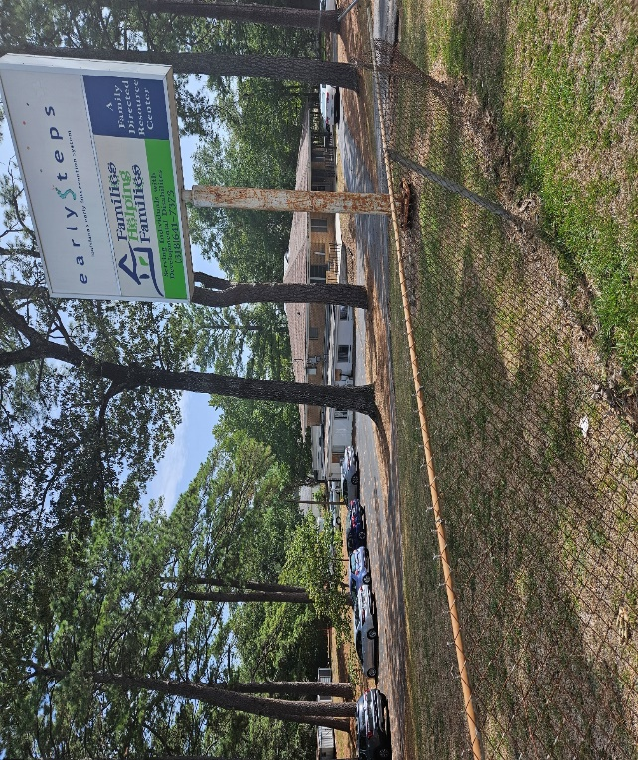
FHF Crossroads Center

Slide 3
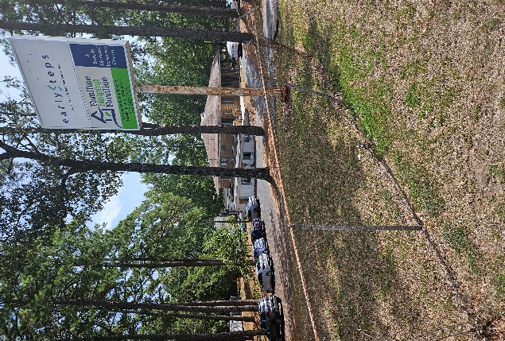
FHF Crossroads Center

Slide 4
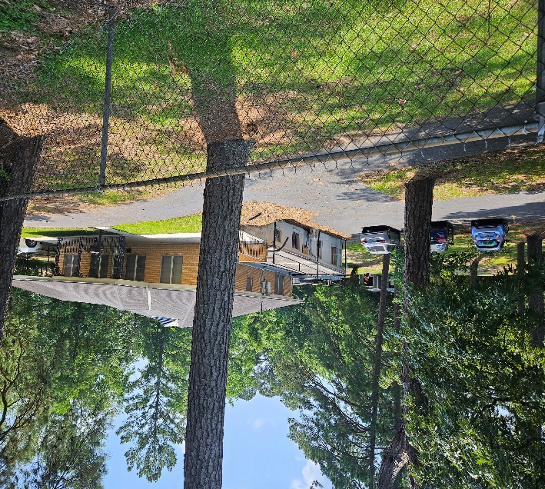
FHF Crossroads Center

Slide 5
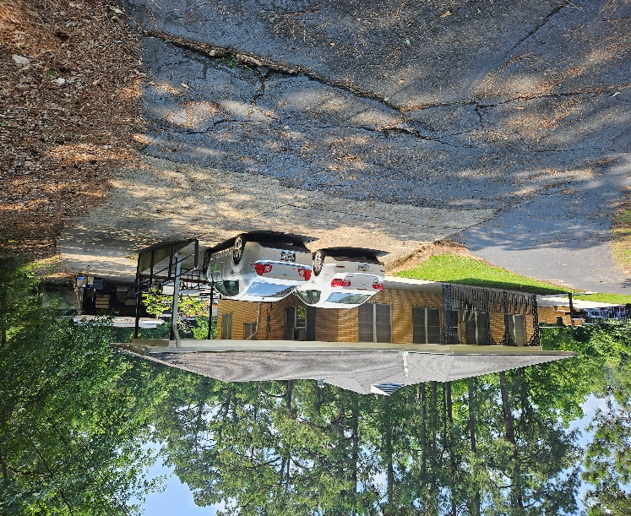
FHF Crossroads Center

Slide 6
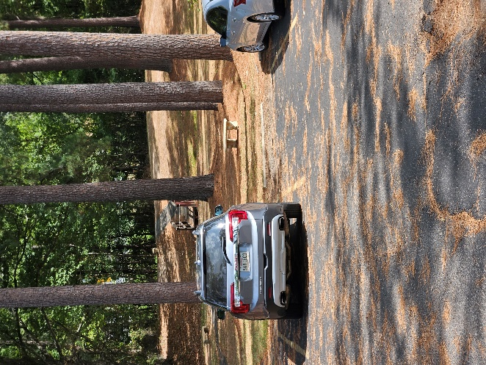
FHF Crossroads Center

Slide 7
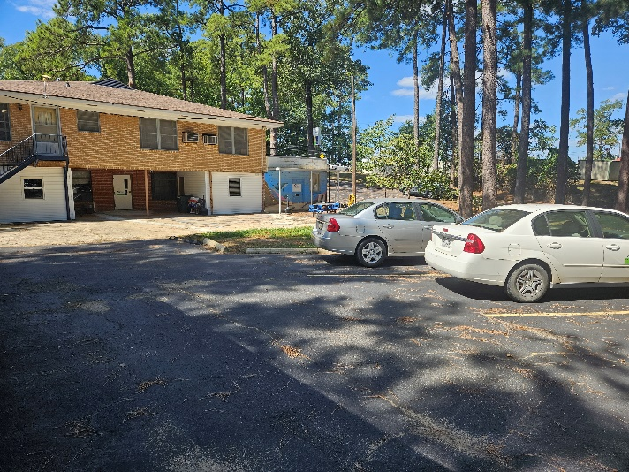
FHF Crossroads Center

Slide 8
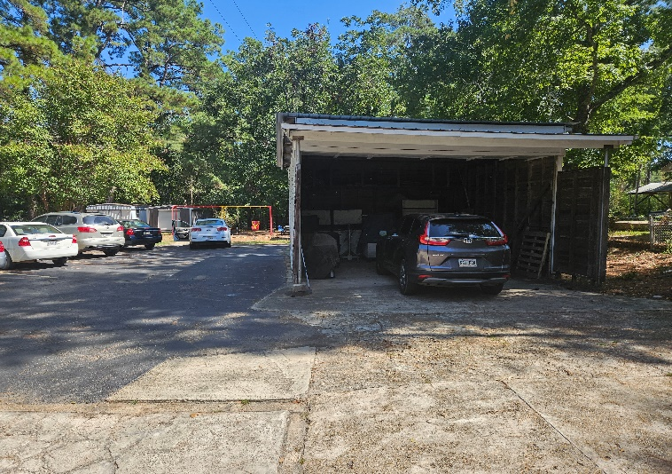
FHF Crossroads Center

Slide 9
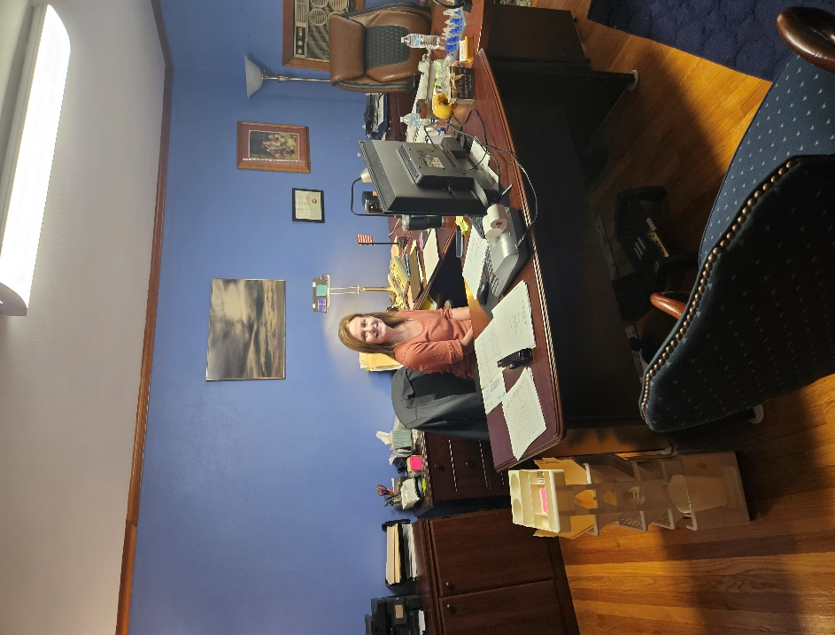
FHF Crossroads Center

Slide 10
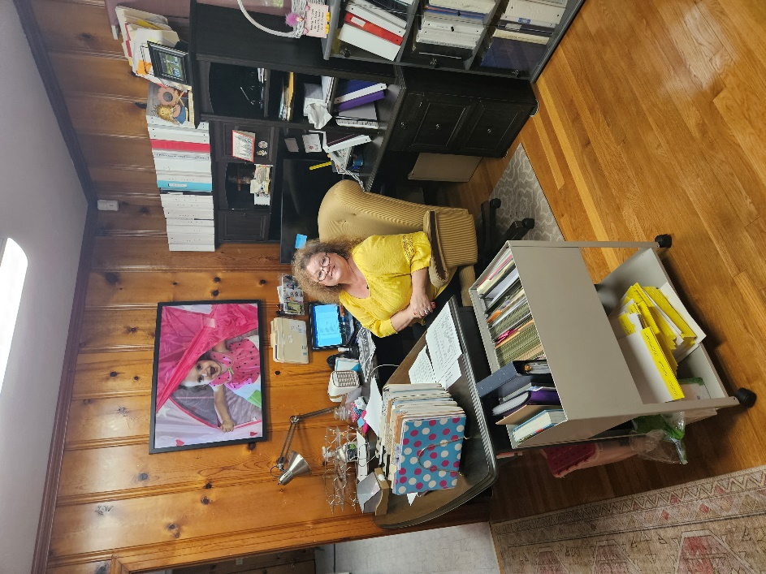
FHF Crossroads Center

Slide 11
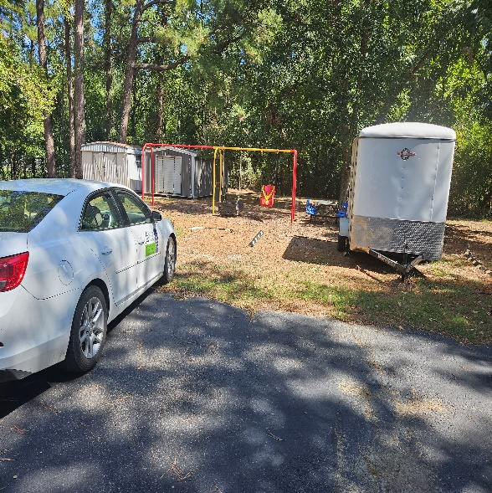
FHF Crossroads Center

Slide 12
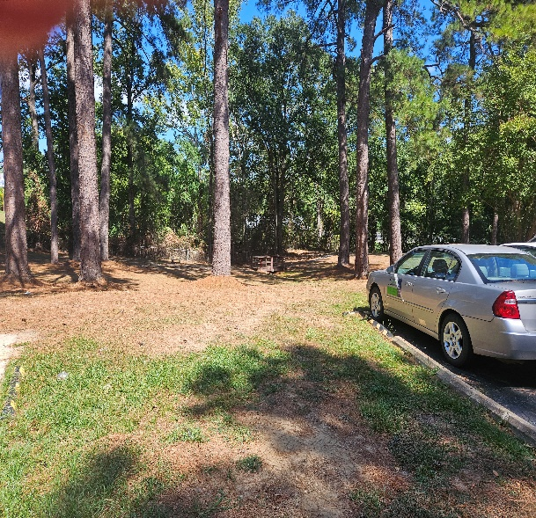
FHF Crossroads Center

Slide 13
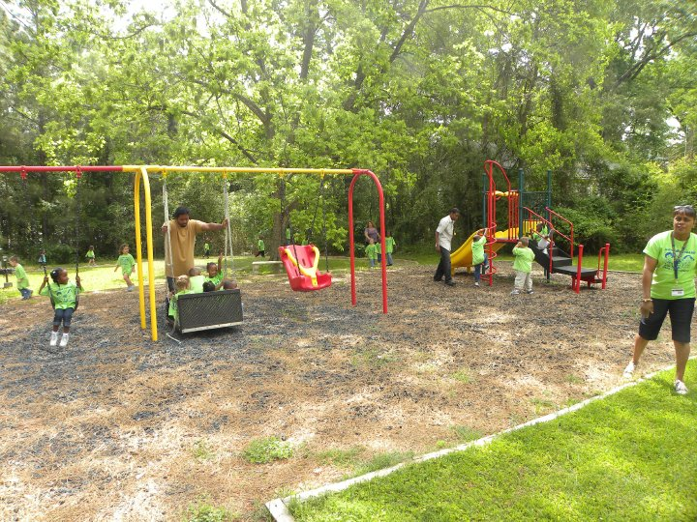
FHF Crossroads Center

Slide 14
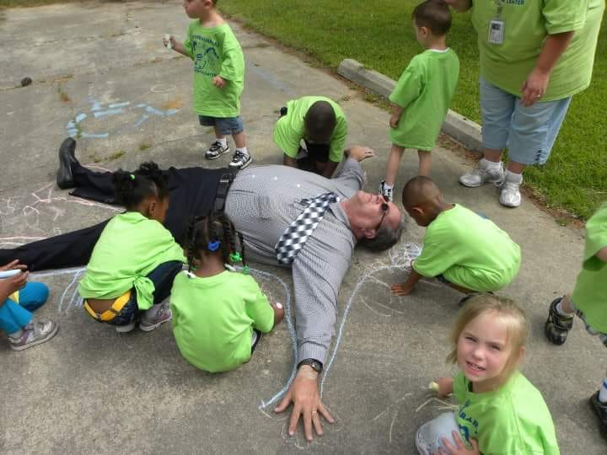
FHF Crossroads Center

